Slide 1
TDS2101 Project Part B
Group B2
1181302678 Amiera Nur Hafidzah Binti Muzaffar
1181302793 Lee Min Xuan
1191301879 Tan Jia Qi

Slide 2
OUR GROUP
Topic : Food and Agriculture Organization (FAO) of United Nations
To gain insights from the datasets in agriculture sector

Slide 3
SUPPORT DATASETS
CLIMATE
FOOD BALANCE
CROPS PRODUCTION
PESTICIDES
FERTILIZERS

Slide 4
Data cleaning/ Data Pre-processing
Remove duplicates rows
Replace null with ‘0’
Filter units calculated
Merging some datasets
Normalize data
Check and remove any duplicate rows
Check for null values for crops production data and replace with zeros
We filter the data units in tonnes instead of hg/ha
Merge datasets from different years
Using MinMax Scaler to normalize numeric data
Notes:
Some values are not suitable for plotting, so we use min max scaler to normalize them

Slide 5
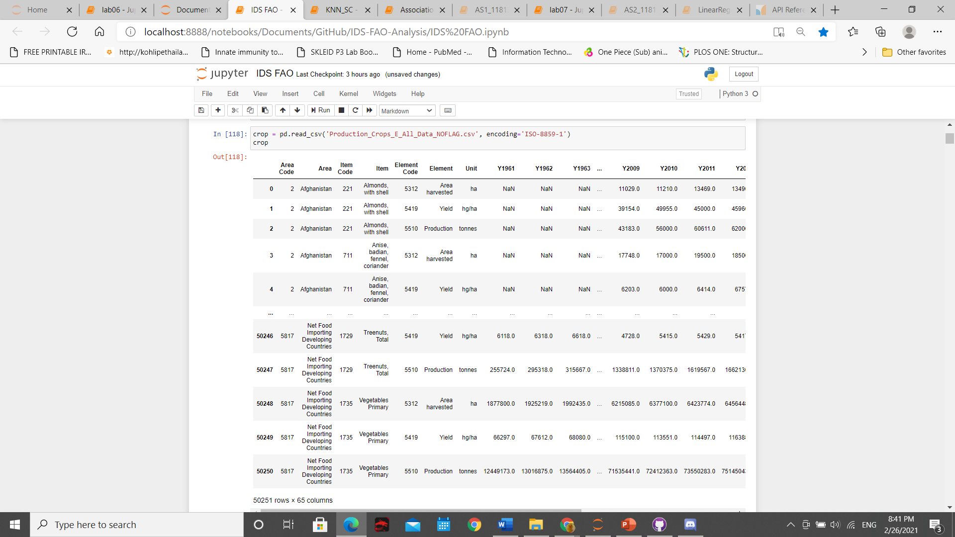
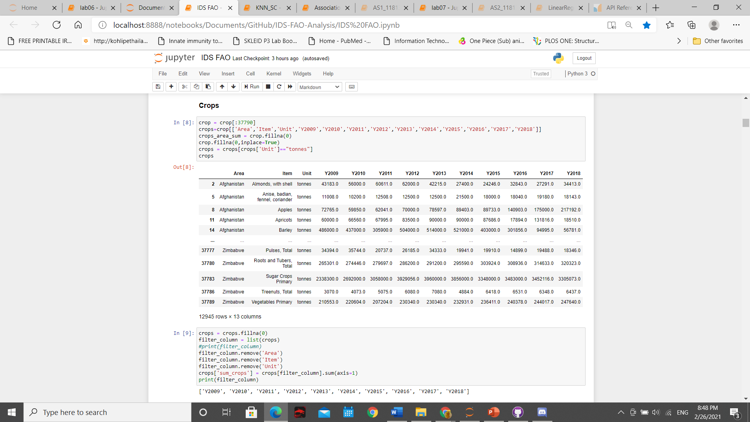
CROPS
PRODUCTION

Slide 6
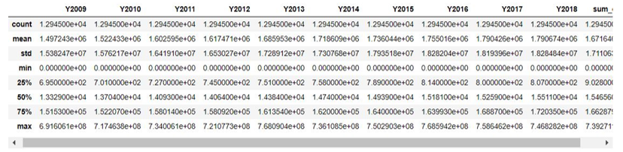
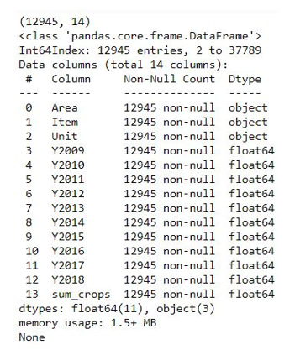
INSIGHTS OF THE DATASETS
CROPS PRODUCTION

Slide 7
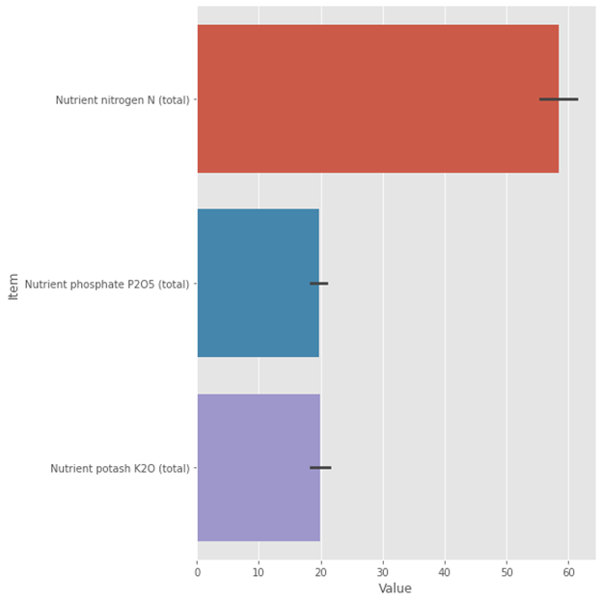
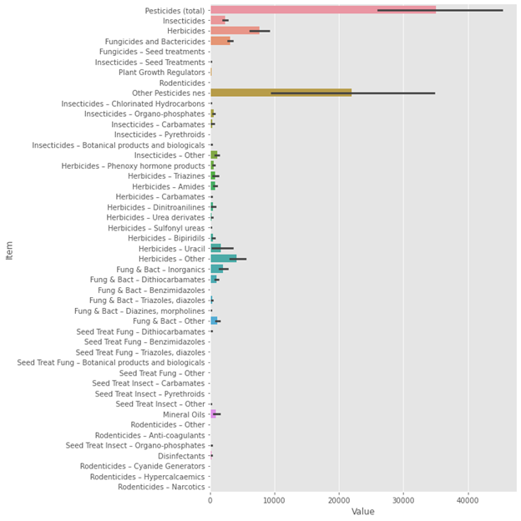
DATA VISUALIZATION
FERTILIZER
PESTICIDES

Slide 8
Questions to be answered
Countries that having low crops production
the Top 5 high demand food
South Sudan
Bhutan
Zimbabwe
Somalia
Eswatini
USSR
Yugoslav SFR
Vegetables, Other
Milk (Excluding Butter)
Rice and products
Wheat and products
Potatoes and products

Slide 9
Top countries harvest the most high demand crops
Turkey
Russian Federation
China
USA
China, Mainland
Indonesia
Bangladesh
India

Slide 10
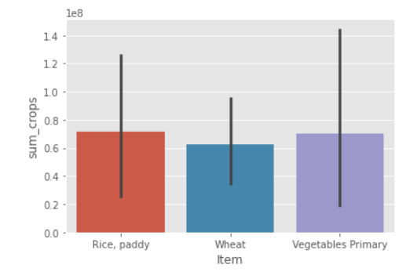
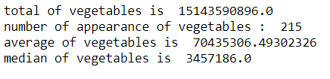
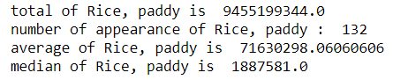
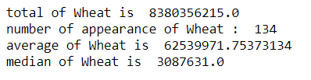
THE SELECTED CROPS PRODUCTION

Slide 11
BEST CLIMATE TO PLANT THOSE HIGH DEMAND CROPS
TROPICAL / SUBTROPICAL
TEMPERATE
DESERT
ARID / SEMIARID

Slide 12
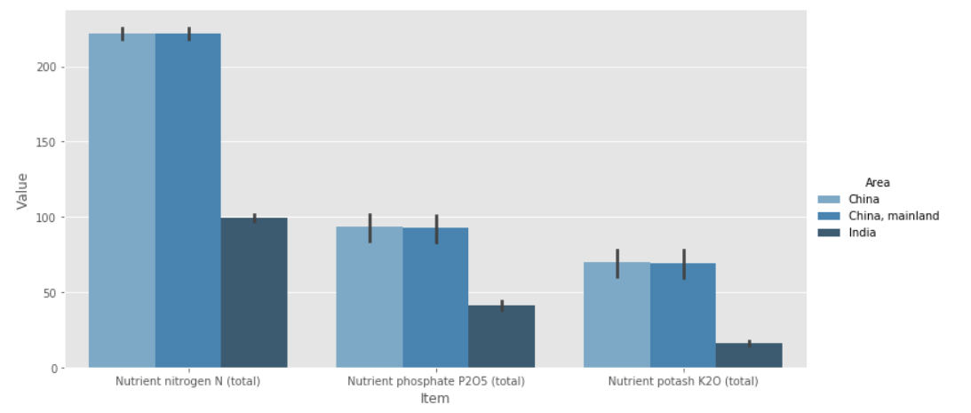
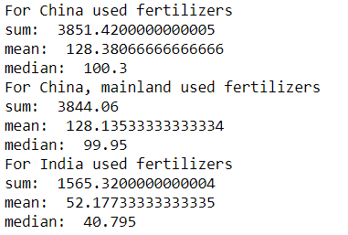
FERTILIZER USAGE FOR SELECTED COUNTRIES

Slide 13
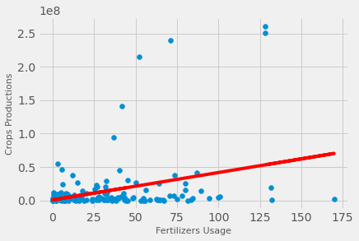
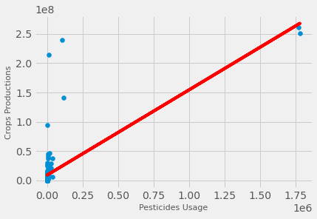
Fertilizer Vs. Crops Production
Pesticides Vs. Crops Production

Slide 14
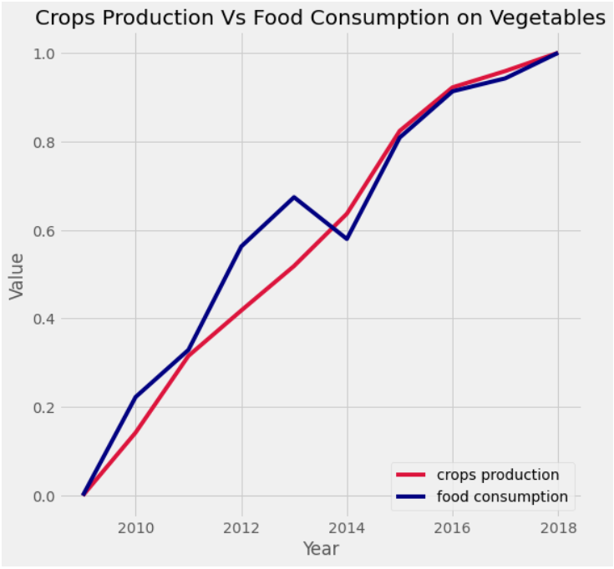
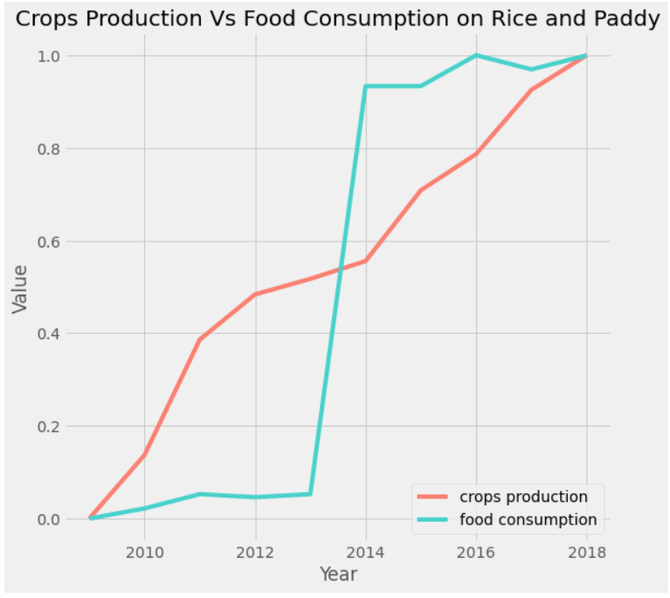
CROPS PRODUCTION VS FOOD CONSUMPTION ON SELECTED ITEMS

Slide 15
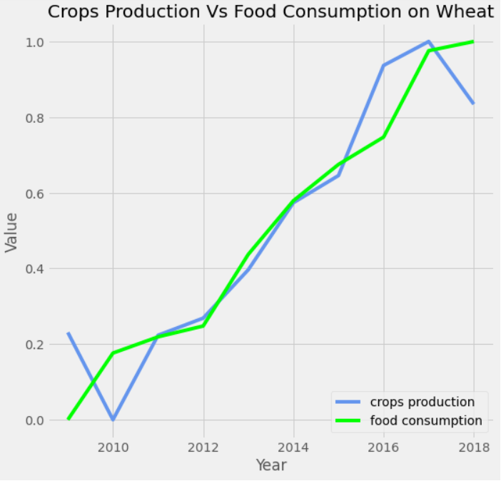

Slide 16
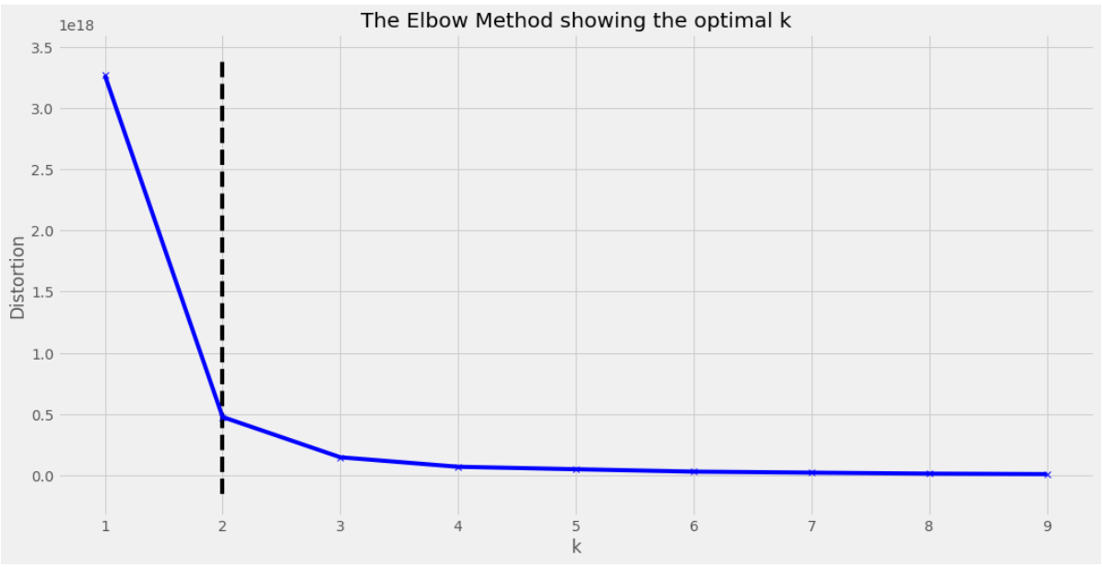
K-MEANS CLUSTERING

Slide 17
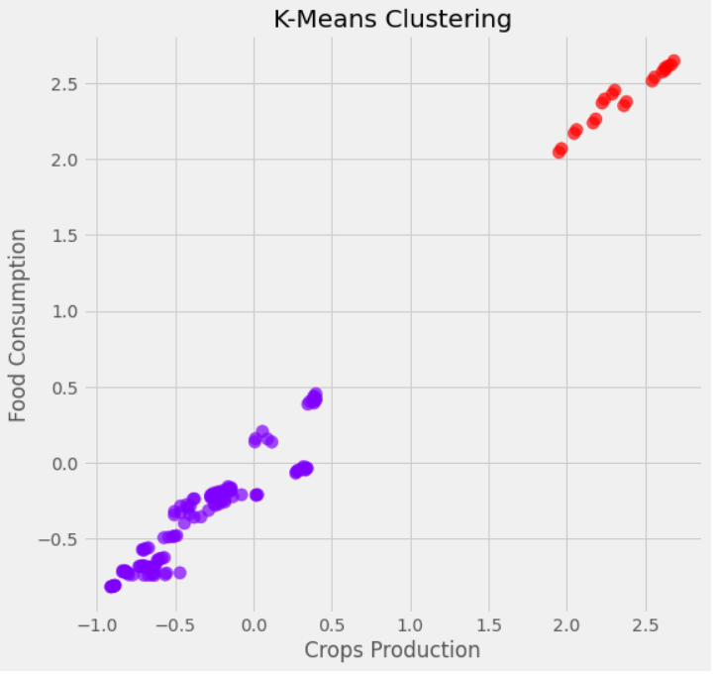
K = 2

Slide 18
Challenges & Future Enhancement
Predictive model
More hidden factors
Try to get a more detailed data or more amount of data then only able to do a forecasting and predictive model for future food consumption.
Explore more confounding factors that will affects our results’ accuracy and take them into considerations.

Slide 19



Conclusion
Will give contribution and insights on crop production
Give useful information on food production in future

Slide 20
Thanks!
Do you have any questions?
]]

